Slide 1
News classification based on similarity
By Mehedi Rahman
Id: 1620647042
Course: CSE445, Section: 01

Slide 2
The Problem
The growth of online news services is increasing day by day.
A large amount of information is being stored in the electronic format.
With the increase in the number of news it has got difficult for users to access news of his interest.
So it is necessary to categorize news so that it could be easily reached by the users.

Slide 3
Proposed solution
My solution is to classify the news articles using Machine Learning approach.
I will use Support Vector Machine (SVM) algorithm for the classification.
The news articles will be classified into predefined labels or categories such as Entertainment, Sports, Music, Education, Economy etc.

Slide 4
Why SVM
SVM is one of the most robust and accurate algorithm among the other classification algorithms.
It finds out a line/ hyper-plane in multidimensional space that separates classes.
SVM works efficiently if we have a huge number of features. So it works well for text classification.
SVM avoids overfitting and we can tune it’s parameters to get more accuracy.

Slide 5
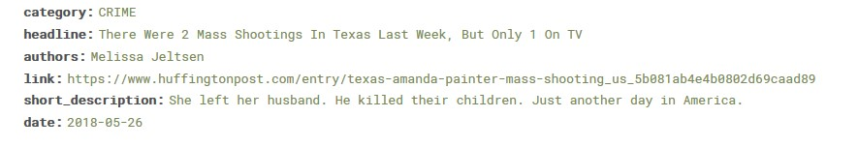
Dataset
I will use this news-category-dataset from Kaggle-
(https://www.kaggle.com/rmisra/news-category-dataset)
This dataset contains around 200k news headlines from the year 2012 to 2018 obtained from HuffPost.
Each news headline has a corresponding category.

Slide 6
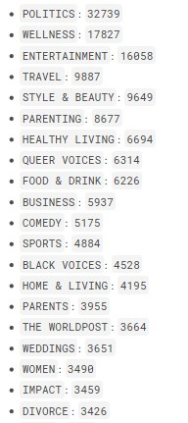
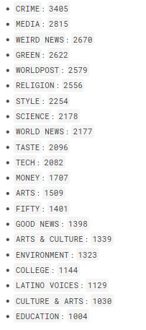
Dataset
We can see that there are data imbalance in this dataset.
I will merge some categories to balance the data.
I can also use Synthetic Minority Oversampling Technique (SMOTE) to balance the dataset.

Slide 7
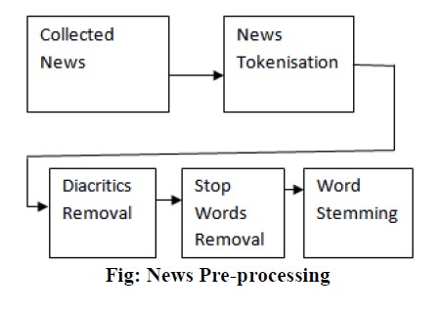
Process
There are different steps involved for the classification.
1. Data Collection
The first step is the data collection. I will use the dataset (https://www.kaggle.com/rmisra/news-category-dataset) which contains around 200k news headlines from the year 2012 to 2018 obtained from HuffPost.
2. Pre-Processing
It is an important step for our process. It includes some steps like tokenization, lemmatization, stop words removal, lowercase all texts etc.
It transforms text into a more digestible form so that machine learning algorithms can perform better.

Slide 8
Process
3. Word Vectorization
It is a general process of turning a collection of text documents into numerical feature vectors. I will use Term Frequency-Inverse Document Frequency (TF-IDF) method for this step.
4. Classification
Finally I will apply SVM algorithm for the classification.
At first I will use Linear kernel of SVM, as most of the text classification problems are linearly separable.

Slide 9
Tools required
Scikit-Learn
Pandas
Numpy
NLTK
Jupyter Notebook

Slide 10
Final Goal
My final goal is to complete all the steps required and implement a robust machine learning model which will perform well in a new input or a different dataset.

Slide 11
Thank you

